Slide 2
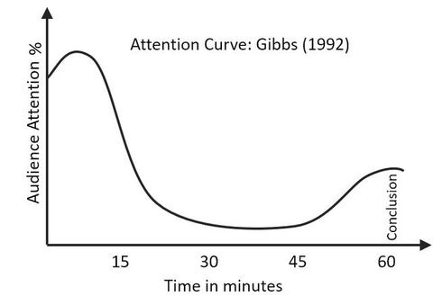

Slide 6
6min
9hrs

Slide 9
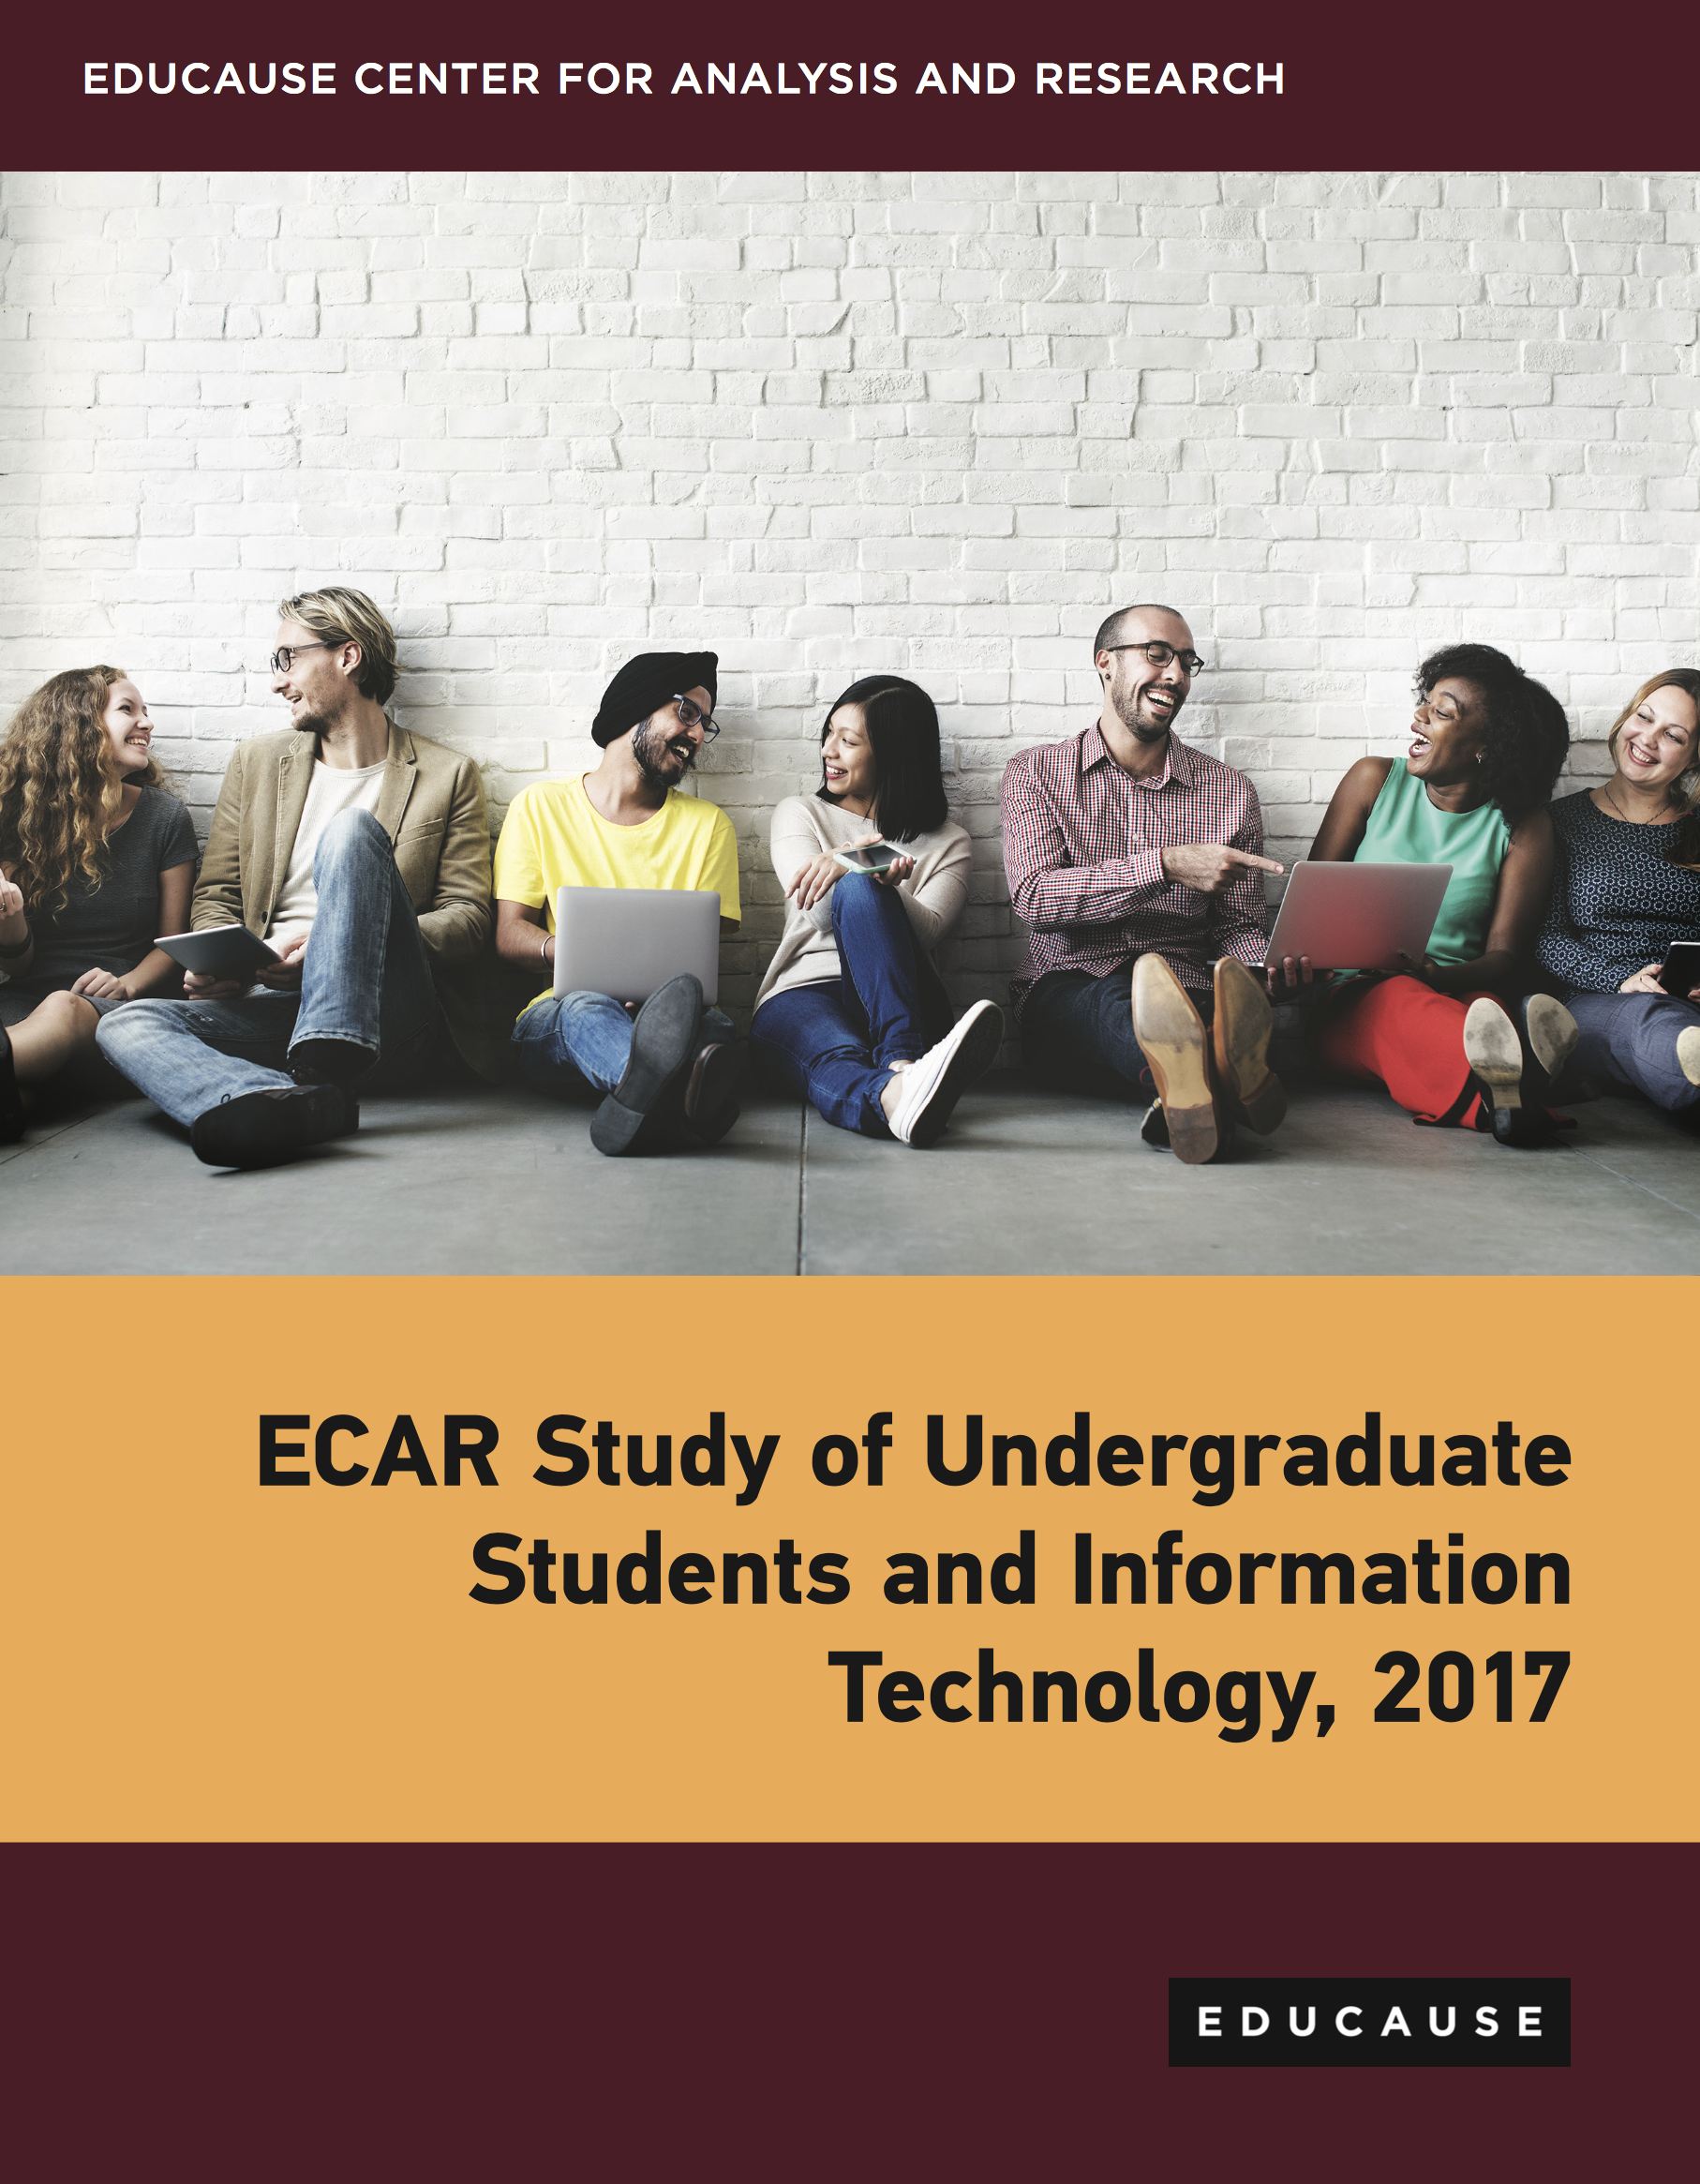

Slide 10
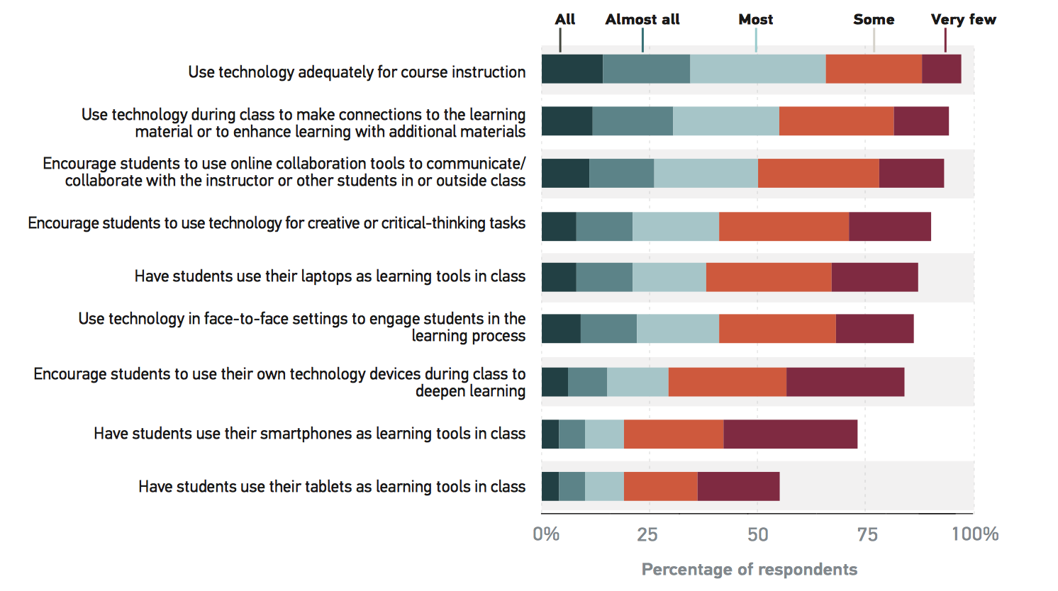

Slide 11
Technologies that provide students with something are more desired than those that require students to give something.

Slide 12
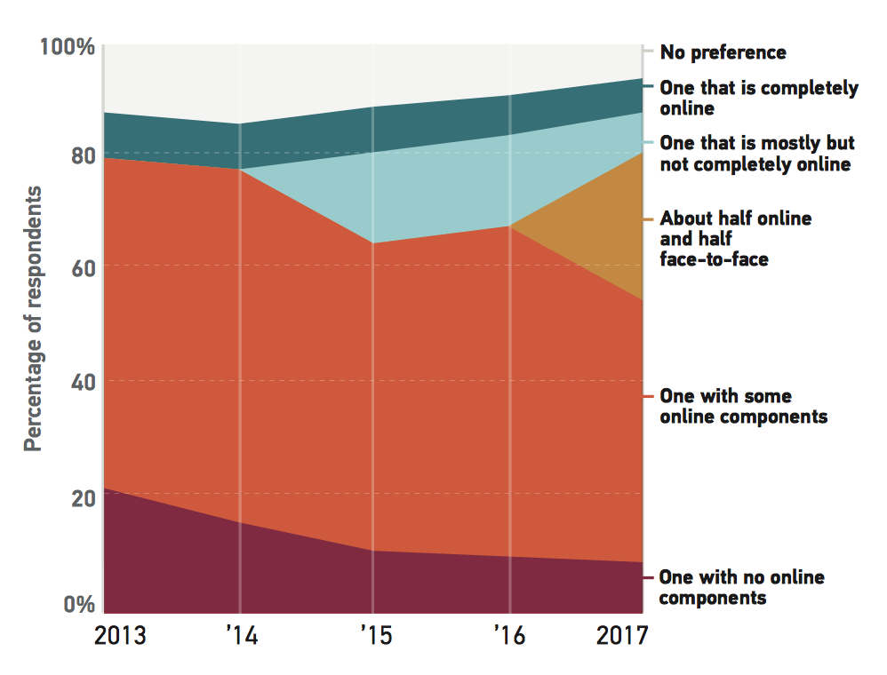

Slide 13
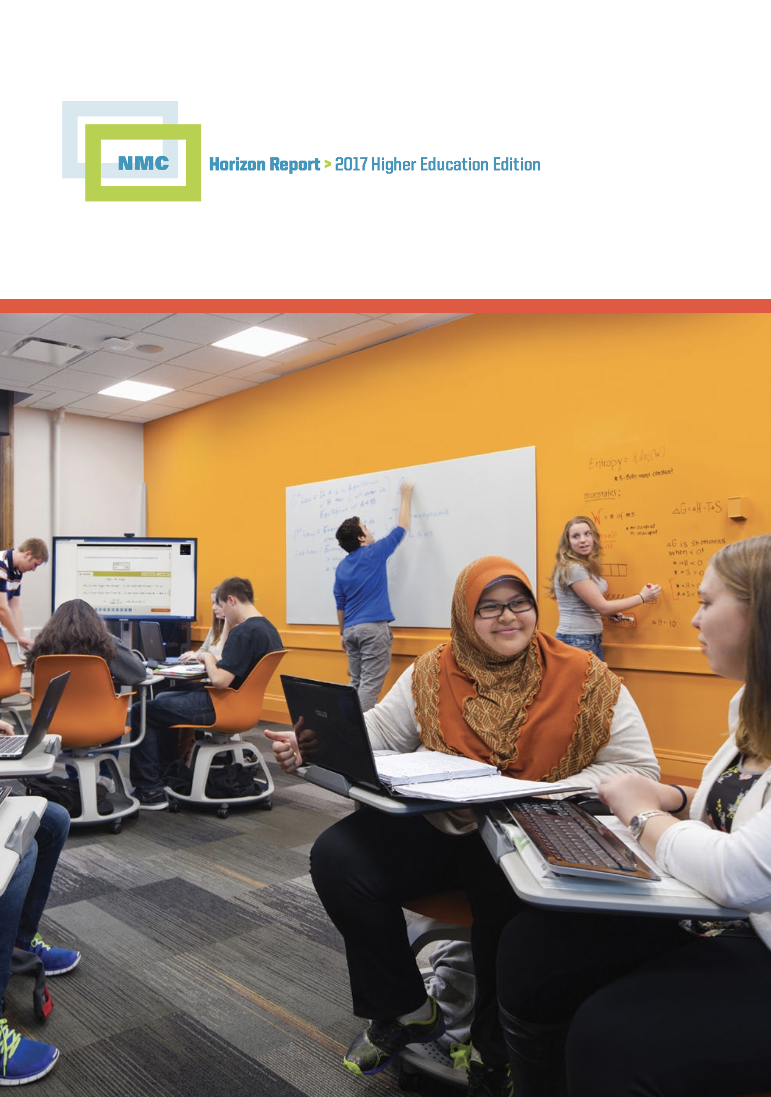

Slide 14
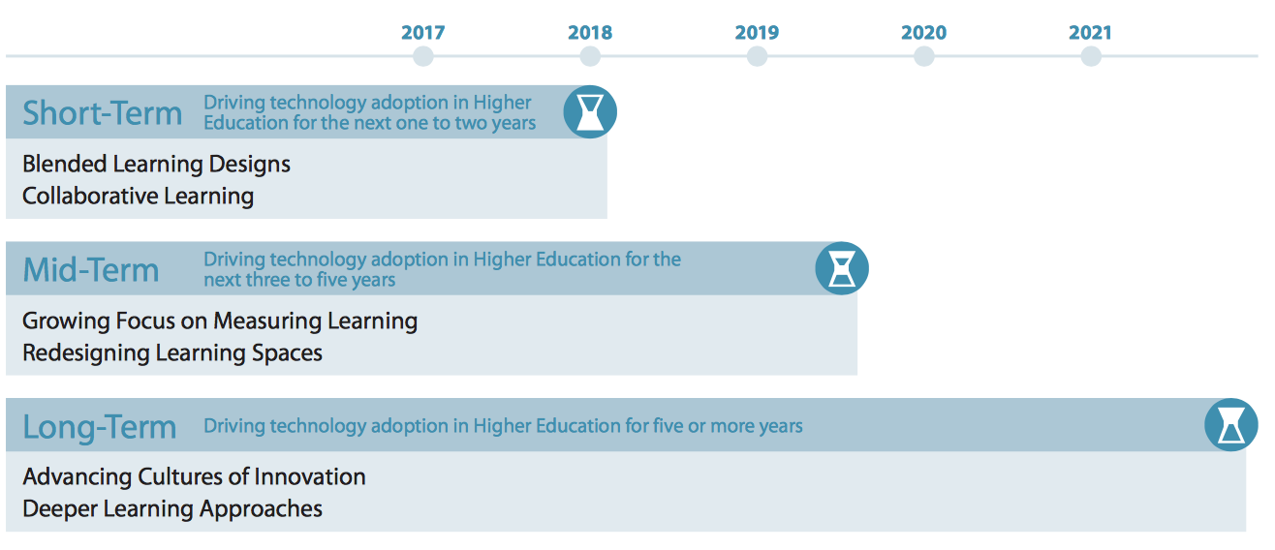

Slide 17
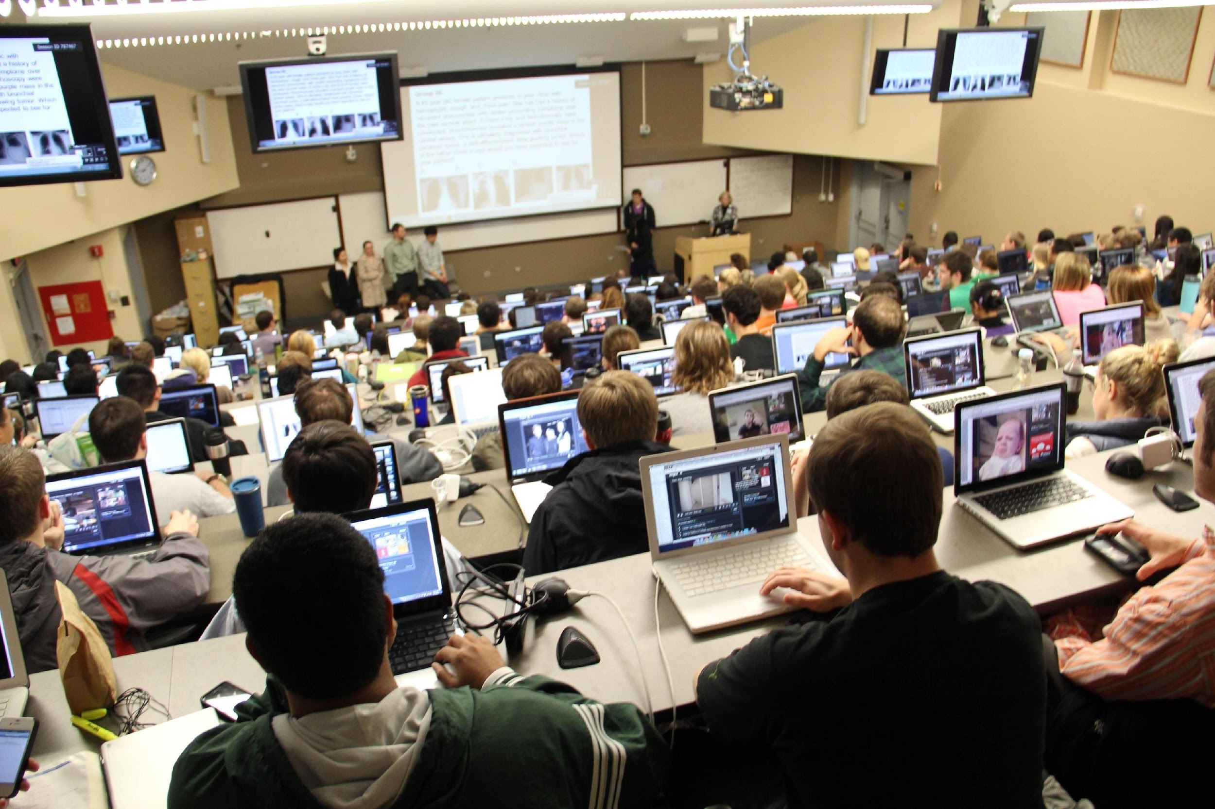

Slide 20
Increase Student Engagement

Slide 21
Provide Constructive and Timely Feedback

Slide 22
7 Principles for Good Practice
Chickering & Gamson, 1987)

Slide 23
Encourage contact between students and faculty
1

Slide 27
Develop reciprocity and cooperation among students
2

Slide 31
Encourage active learning
3

Slide 34
Give prompt feedback
4

Slide 36
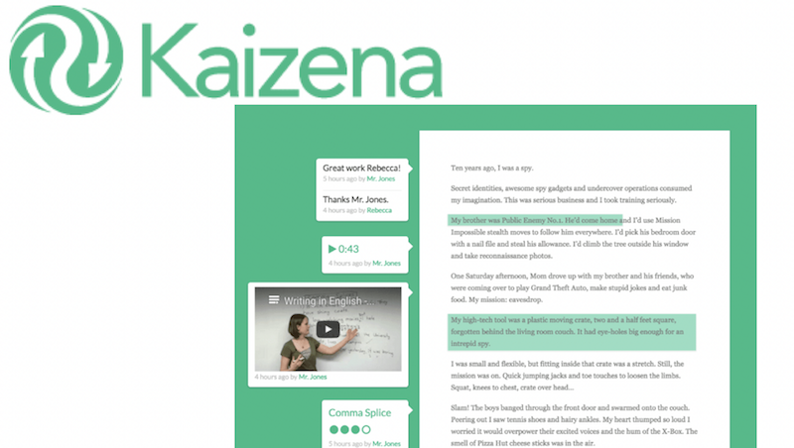

Slide 38
Emphasize time on task
5

Slide 40
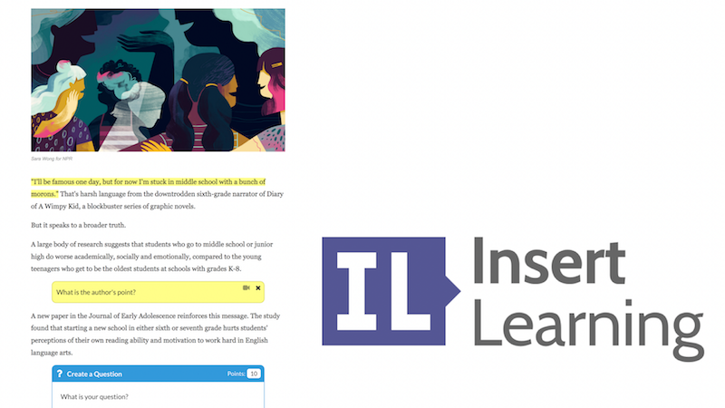

Slide 41
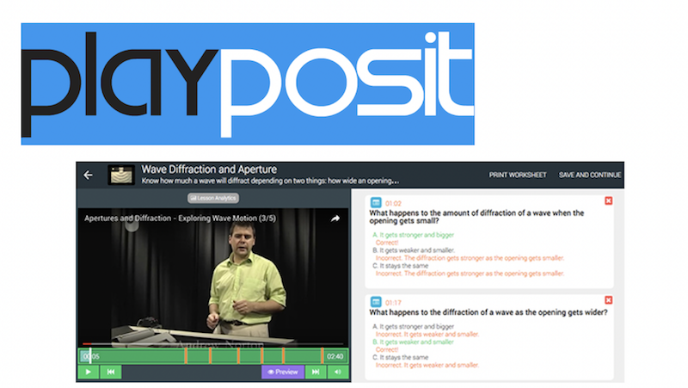

Slide 42
Communicate high expectations
6

Slide 46
Respect diverse talents and ways of learning
6

Slide 51
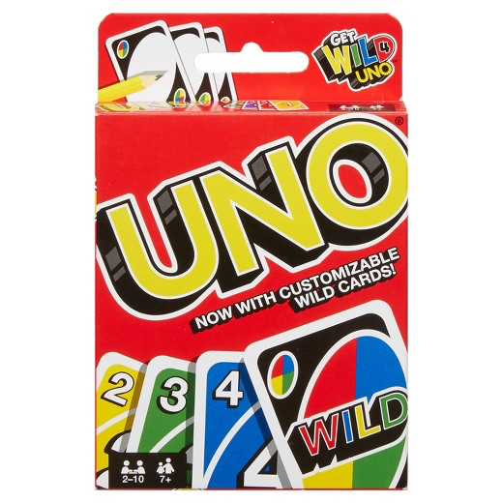
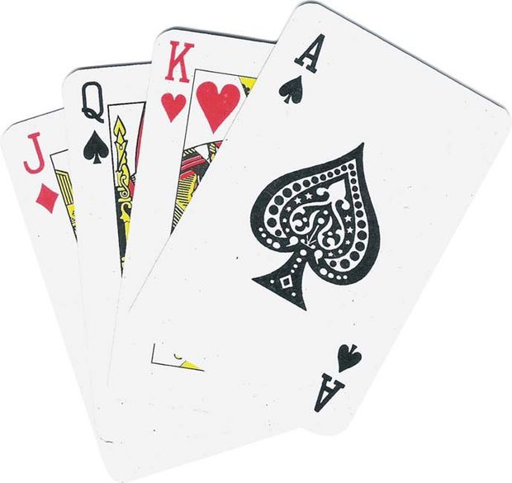

Slide 53
TPACK
GAME

Slide 55
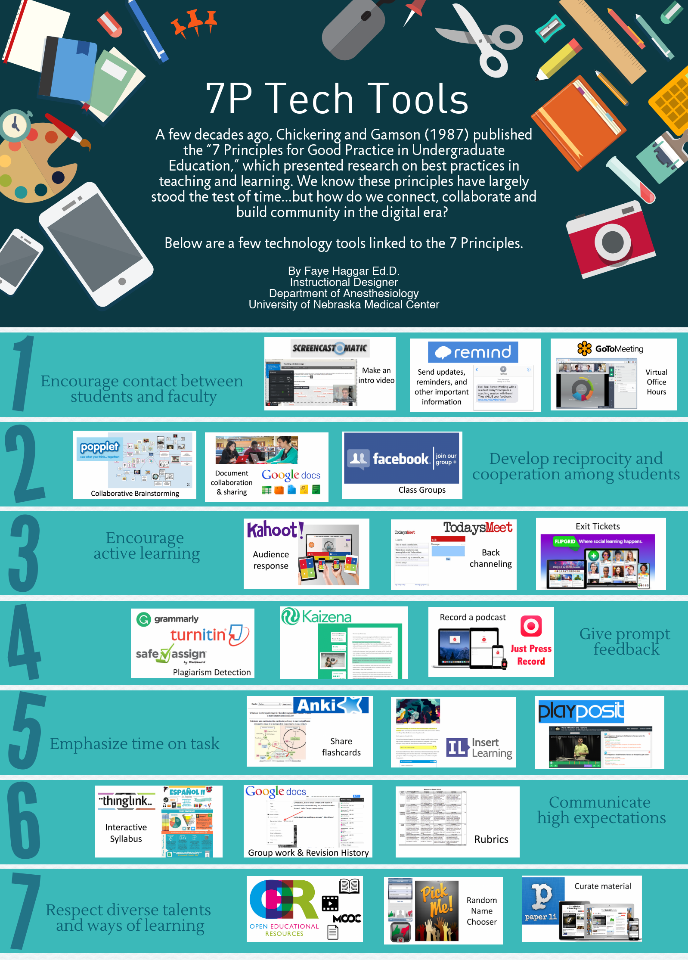
Thank You
Faye.Haggar@unmc.edu
@fayehaggar

