Slide 1
Steelcase/NMC Active Learner-Centered (ALC) Academy
In this session: Higher Order and Highly Engaged
Harsha Sharma, Ph.D., Professor, Arts & Sciences
Larry W. Hughes, Ph.D., Associate Professor, CREATE

Slide 2
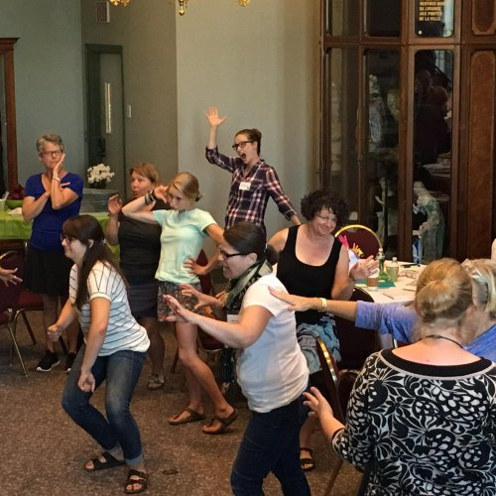
“student-faculty interaction, peer-to-peer collaboration, and active learning…” (Chen, Gonyea, & Kuh, 2008).
Positive correlation with learning experience
Social learning/cognitive theories (Bandura, 1977; 1986)
Individual
Behavior
Environment
What is engagement?
Notes:
In another session we talked of engagement…’clicking with and involving the learner in the process of learning.’ Engagement has been shown to relate to ownership and commitment as well as reduced absenteeism.
The ‘triarchic model’ Critical thinking Crea)tive thinking Practical thinking Fink (2013); Sternberg (1998)

Slide 3
Higher Order Thinking
Critical
Thinking
H-O-T
Transfer
Problem
Solving
Notes:
In a nutshell, higher order thinking is the idea is that some types of learning require more cognitive processing than others (e.g., Bloom), but also have more generalized benefits.
Higher-order thinking skills go beyond basic observation of facts and memorization. They are what we are talking about when we want our students to be evaluative, creative and innovative.

Slide 4
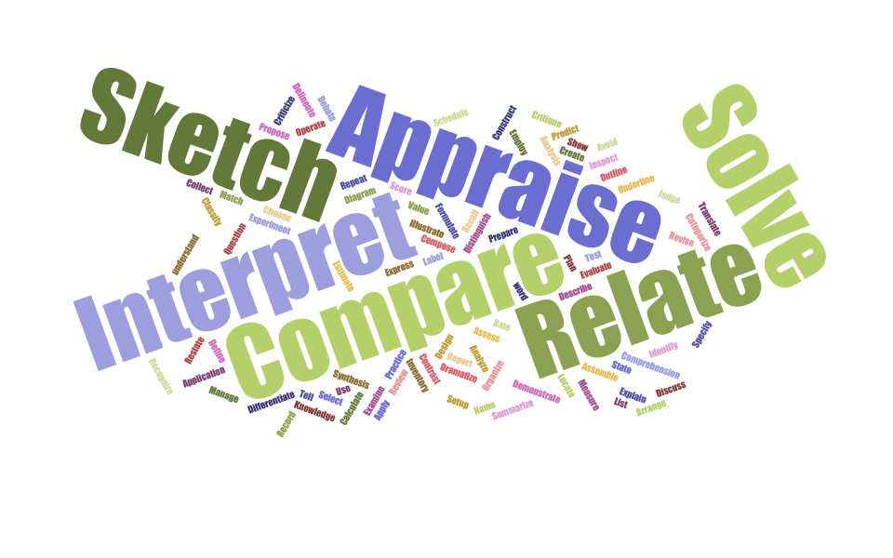
The world according to Bloom
Measuring critical thinking and engagement…align the objectives!

Slide 5
Assignment…Design a course to teach the concept of ‘higher order thinking’
Profile your audience
Identify the ‘big idea’ (overarching objective)
Draft two course objectives using terminology from the handout (Hint. Tap into the factors that comprise H-O-T)
For each objective, identify a measurable activity
Notes:
The “big idea” is the take-away that you want all learners to have in this experience. Stop and ask a couple of teams what their big idea is (write it on the whiteboard)
Write course objectives on the whiteboard.
Write brief description of activity

Slide 6
Debrief
Consider your activity…
What does this course look like?
How will learners be engaged? Is anyone left out?
Notes:
White board?

Slide 7
Now, the big question…
In your individual classrooms…
How do you teach H-O-T ?
How do you engage learners?

Slide 8
Do you know what we just did?
We used higher order thinking to develop an abbreviated course about…
…higher order thinking!

Slide 9
Parting shot…
… For further consideration…
What specific strategies enable you to ‘engage’ the learner?
What specific strategies enable you teach critical thinking?
How do you leverage one to accomplish the other?
Notes:
When we say ‘critical thinking’ we sometimes mean true CT, but sometimes creative or practical thinking. Creative thinking implies the production of something ‘novel’ and ‘valuable.’ Creativity, in this sense, can mean drawing on a variety of elements from different sources and integrating them into a new structure…connect and synthesize are common verbs. Practical thinking is when students learn how to answer questions, make decisions, and solve problems. All three can be measured using AAC&U VALUE rubrics.

