Slide 1
Steelcase/NMC Active Learner-Centered (ALC) Academy
In this session: Roadmaps for teaching and learning
Harsha Sharma, Ph.D., Professor, Arts & Sciences
Larry W. Hughes, Ph.D., Associate Professor, CREATE

Slide 3
We’re all different…and so are our learners!
Notes:
How do you design and build your course experiences? Who has taken a course in pedagogy and learning theory? Or a course on how to teach?

Slide 5
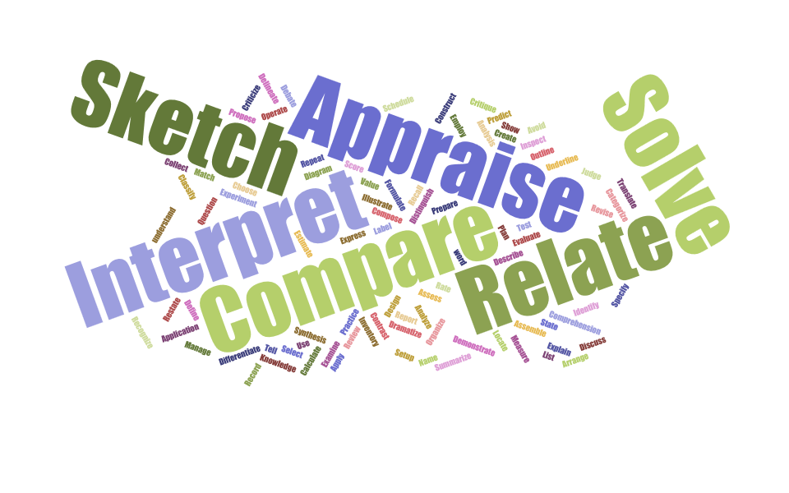
Learning theories
Bloom
Educational Psychology
Behaviorist
Cognitive
Humanistic
Social learning
Five common paradigms
Behaviorism
Cognitivism
Constructivism
Design-based
Humanism
Other
Multiple intelligences
Social Reconstructivism
Perennialism
Essentialism
Existentialism
Progressivism/Pragmatism

Slide 6
Learning strategies … too many to count! What do YOU do in class?
Notes:
How do you design and build your course experiences? Who has taken a course in pedagogy and learning theory? Or a course on how to teach?

Slide 7
Focus on three…
Learning Theory | Learning Process | Activity
Behaviorism | Reinforcement | Strategy simulation with practice decisions before launching sim
Cognitivism | Rehearsing information and storage for information retention and long term use | Flashcards and interleaving assessments
Constructivism | Constructing knowledge through past experiences and group collaboration | Learner-led wiki project

Slide 8
Let’s put this to work!
In your course, you intend to discuss society’s over reliance on technology and ask for solutions
Using the learning theory provided to your team…
Discuss how you would teach this topic?
Write a course objective (using action verbs, e.g., illustrate, suggest, etc.)
Identify an aligned activity that resembles the theory you were assigned
Notes:
Assign a theory to work toward

Slide 9
Now … build personality diverse teams!
Discuss
How did it feel to be guided by a theory? Dissonance?
Limitations of your theory?
How did the group work differ from YOUR preferred method/style?

Slide 10
Closing … How do you teach?
Think about…
The strategies do you use in class to empower learner
The learning theory that informs your work

