Slide 1
Making the Most of Test Analysis & Statistics
Meg Blair PhD RN
Marla Kniewel EdD RN

Slide 2
Objectives
Describe which test analysis statistics are important to evaluate
Remark scantron
MyMethodist
Discuss key points in test item evaluation
Describe important elements of writing a good test item

Slide 3
Test Analysis Statistics
Overall test performance
Measures of Central Tendency
mean
median
range of scores
Reliability of test
Kuder-Richardson Formula 20 (KR-20)
0-1
Closer to 1, the better the test
> 0.50 considered a good test

Slide 4
Test Analysis Statistics: Test Items
Item Difficulty
p-value (0-1)
Closer to 1, easier the question
Item Discrimination
Point biserial (-1.0 to +1.0)
Discriminates between high scoring students & low scoring students
< 0.30 | Too Difficult
0.40 - 0.80 | Good
> 0.80 | Too Easy
> 0.40 | Very good
0.30 – 0.39 | Reasonably good Subject to improvement
0.20- 0.29 | Marginal items Need Improvement
< 0.19 | Poor items Reject or Revise

Slide 5
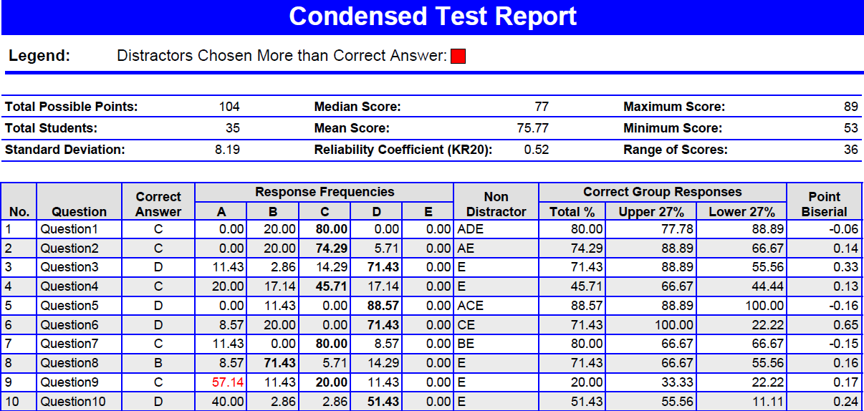
Remark Scan Analysis
Low p-value
Low Point Biserial

Slide 6
Test Item Analysis: MyMethodist
Item Difficulty
Difficulty Rating (0 - 1)
Closer to 1, harder the question
Can change settings
Item Discrimination
Discrimination Index (0 - 1)
Closer to 1, harder the question
Can change settings
< 0.20 | Too Easy
0.20 - 0.80 | Good
> 0.80 | Too Hard
> 0.20 | Good discrimination
< 0.20 | Poor discrimination

Slide 7
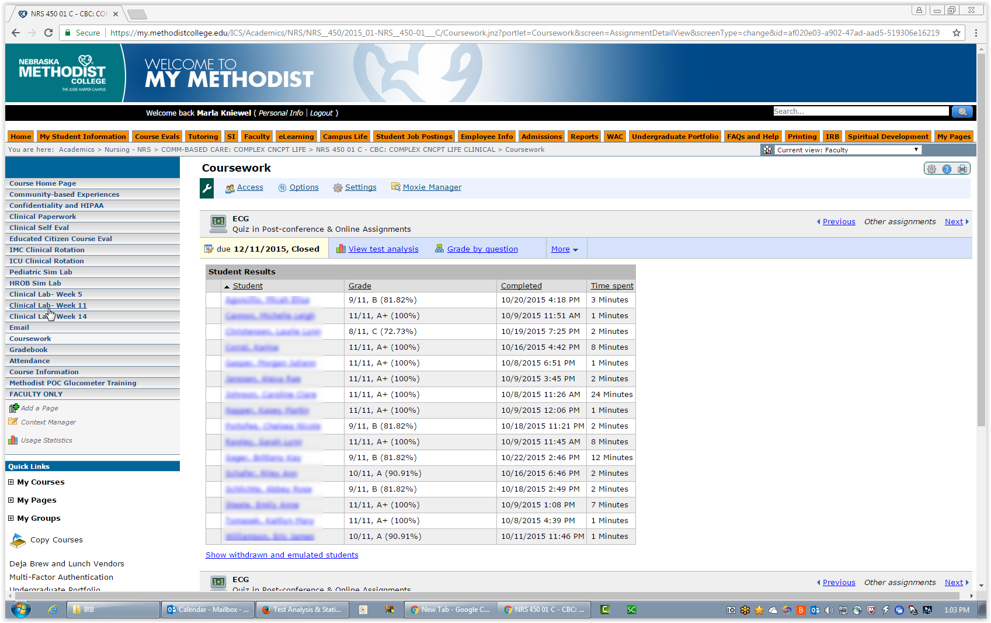
Coursework – Assignment

Slide 8
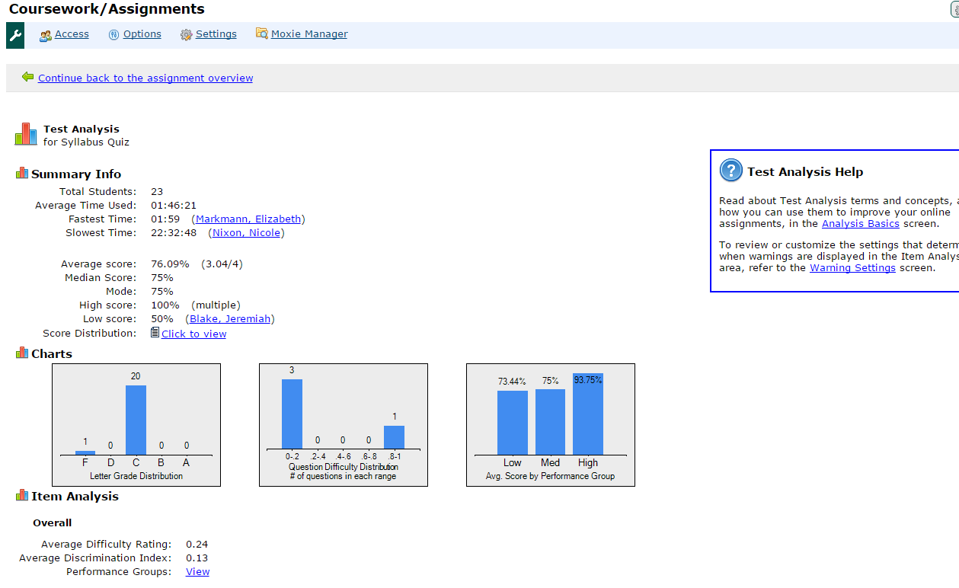
Help!
Measures of Central Tendency
Distribution of Scores
Overall Test Performance

Slide 9
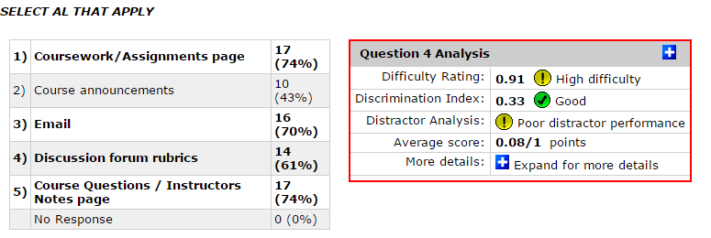
Click on to look at distractor analysis

Slide 10
Test Item Analysis: Decisions
Immediately after test
Look at all test items with p value (difficulty) below 0.40
Look at point biserial (discrimination) for those items (<0.20 or 0.30)
Look at % for each answer option
Decision time

Slide 11
Test Item has bad statistics, so now what?
Accept another response
Another faculty review question
Evaluate if additional response is valid
Revise question before use question again
Throw out the question
Give points to students who got item wrong
Remove item from test, recalculate scores based on less total test items
Give back the question
Give all students the points
“Curves” the test
(Billings & Halstead (2016), McDonald, 2014)

Slide 12
Self-Assessment
Review the following test item statistics:
What can you conclude about this test item?
The distractors were implausible and should be replaced
Low scoring students got this item correct more often than high-scoring students.
More than 10% of the class answered this question incorrectly.
This test item showed high discriminative ability and should be retained.

Slide 13
Writing Great Test Items
For the stem:
The best stem is 2 lines long: “setup” & question
This is not a reading test.
Guidelines are 1- 1 ½ min/question for simple multiple select.
Test questions should stand alone
no little case scenarios with multiple questions.

Slide 14
Writing Great Test Times
For the options: No “K” questions
Blah, blah, blah
More blah, blah, blah
Even more blah, blah, blah
Both a and b are correct
Both b and c are correct
Instead use “Select all that apply”
single stand alone option
second stand alone option
third stand alone option
fourth stand alone option
fifth stand alone option

Slide 15
Writing Great Test Items
Answer options should be randomized by some fashion…
Alphabetize
Length
Numerical ordering
All answer options should be reasonable and “tempting” to the student who does not know the material

Slide 16
Writing Great Test Items
Keep answer options a similar length
This is an incorrect option
Another incorrect option
This is the correct option which is easy to spot since it’s way too long because you are explaining something and trying to lead the student to this answer so it’s a dead give away
A final incorrect option

Slide 17
Revising Test Items: Decisions
Distractor analysis
Revise test items with poor stats immediately after exam
Easier to remember “why” & “what” to revise
Review history of stats for test item over time
All questions may not need revised
Look at other questions with low point biserial
Revise poor distractors

Slide 18
References
Billings, D. M. & Halstead, J.A. (2016). Teaching in nursing: A guide for faculty (5th Ed.).
St. Louis, MO: Elsevier.
Garino, A. & Van Rhee, J. (2009). Test item analysis for the physician assistant educator.
The Journal of Physician Assistant Education, 20(3), 22-27.
McDonald, M. (2014). The nurse educator’s guide to assessing learning outcomes
(3rd Ed.). Burlington, MA: Jones & Bartlett.
Phelps, S., McDonough, S., Parker, R., & Finks, S. (2013). Throwing a curve ball: The
impact of instructor decisions regarding poorly performing test questions. American Journal of Pharmaceutical Education, 77(9), 204.

