Slide 1
Intentional and Focused Learning via Rubrics NMC Lunch & Learn Spring 2017
Marla Kniewel, EdD RN
Marlin Schaich, PhD

Slide 2
Why use rubrics?
Students’ advance understanding of expectations on assignments
Encourage students’ use of critical thinking
Timely & meaningful feedback
Facilitate communication with others
Consistency in grading for a class
Consistency in grading throughout an entire program
(Stevens & Levi, 2005)

Slide 3
Lunch & Learn Objectives
Describe the convenient grading/assessment strategies facilitated by rubrics
Describe ways in which rubrics can become dynamic teaching tools for student learning
→ Time set aside for sharing ideas ←

Slide 4
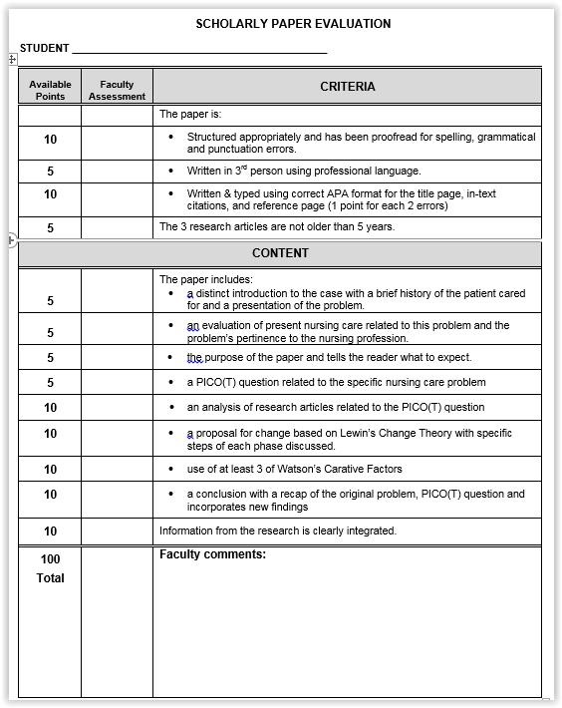
Developing Rubrics: It’s a process!
“Before & After” Story
Scholarly paper grading problems
Developed from guidelines
Poor student scores
Many questions re: expectations
Inconsistent grading
Students challenged grades

Slide 5
1st Version of Rubric
Summer 2012
Developed from expectations
Better overall grades
↓ questions on expectations
↑ consistency in grading

Slide 6
Final Version of Rubric
Summer 2016
Consistency in grading
Interrater reliability >90%

Slide 7
Rubric Design Principles
Collaboration recommended
Four “parts” (Stevens & Levi, 2005):
Assignment/Task Description
Scale/Grades/Levels of Achievement
Dimensions (Breakdown of skills/knowledge)
Descriptions of performance on a grid

Slide 8
Rubric Design Principles: The Grid
“Exemplary” (high) to “Inconsistent” (low),
Left to Right
Concise yet ample “description” of expected performance
Wide range of variety in design choices:
Number of ranges of scores
Level of detail in descriptions of achievement
Category-specific scores, or holistic score

Slide 9
Stevens & Levi, 2005

Slide 10
Stevens & Levi, 2005

Slide 11
Stevens & Levi, 2005

Slide 12
Stevens & Levi, 2005

Slide 13
Benefits to Faculty
Reveals evidence of effective teaching
Identify areas for improvement in instruction (Malini Reddy & Andrade, 2010)
Track changes of student performance as refine teaching methods (Andrade, 2000)
Higher achievement & deeper learning by students (Malini Reddy & Andrade, 2010)
Makes your expectations very clear
Helps students understand the target for their learning (Malini Reddy & Andrade, 2010)
Clarifies vague fuzzy goals (Suskie, 2009)
Justifies assigned grades (Andrade, 2000)

Slide 14
Benefits for Faculty
Streamlines scoring process
“makes grading faster and easier” (Stevens & Levi, 2005, p. 73)
Scoring is more accurate, unbiased & consistent (Andrade, 2000)
More objective basis for evaluation
Increased inter-rater reliability
Use as a tool to plan/revise assignments
Provides informative feedback
Pinpoints strengths & areas to improve
Provides areas that need development or review
Tool to address weak learning without singling out individual students; can reduce need for individual student conferences (Stevens & Levi, 2005, pp. 25-26)

Slide 15
Challenges for Faculty
Requires advance, detailed planning
May include collaboration with other faculty
Need to train other faculty on scoring
Determining language of descriptors
May require frequent or continual revision
to increase student understanding
to match revised assignments
to correct misguided weightings
Marla’s recent challenge: version 1, version 2

Slide 16
Benefits for Students: Before Starting Assignment
Advance understanding of expectations (Rosenberg
& Marks, 2016)
Opportunity for clarifying questions if Rubric part of
class discussion
Creates intentions for learning, for more focused
learning goals

Slide 17
Benefits for Students: During Assignment
Encourages students to use critical thinking
Rubrics lead to analytical approach, prompt self-assessment/evaluation of progress
Reference point for guiding efforts, time through
assignment
Higher achievement (though qualified) (Andrade, 2000; Howell, 2013)
Especially when combined with student self-assessment (He & Canty, 2012)

Slide 18
Benefits for Students: After Assignment
Feedback less surprising, more meaningful
Student learning through comparing grades:
consistent measures
Encourages focused goal-setting for future
growth
Post-scoring student-teacher conferences
may lead to revision of rubric (Rosenberg &
Marks, 2016)

Slide 19
Drawbacks of Rubrics for Students
Not universal panacea as learning tool
(Penner, 2013)
A tool that must be combined with other
teaching techniques
Some students will see rubric language as
vague, too lofty

Slide 20
References
Almagno, S. (2016, February 15). Rubrics: An undervalued teaching tool [Effective Teaching Strategies RSS Feed]. Faculty
Focus. Retrieved from http://www.facultyfocus.com/articles/effective-teaching-strategies/rubrics-an-undervalued-
teaching-tool/
Andrade, H. G. (2000). Using rubrics to promote thinking and learning. Educational Leadership, 57(5), 13-18.
He, X. & Canty, A. (2012). Empowering student learning through rubric-referenced self-assessment. The Journal of
Chiropractic Education. 26(1), 24-31.
Howell, R. J. (2013). Grading rubrics: Hoopla or help? Innovations in Education and Teaching International, 51(4), 400-
410. doi:10.1080/14703297.2013.785252
Penner, I. S. (2013). Comparison of effects of cognitive level and quality writing assessment (CLAQWA) rubric on
freshman college student writing. College Student Journal, 47(3), 447-461.
Malini Reddy, Y. & Andrade, H. (2010). A review of rubric use in higher education. Assessment and Evaluation in Higher
Education. 35(4), 235-248. DOI: 10.1080/02602930902862859
Rosenberg, H., & Marks, L. (2016). Challenges in developing a rubric to assess community-based learning. Assessment
Update, 28(3), 8-12.
Stevens, D. D., & Levi, A. J. (2005). Introduction to rubrics: An assessment tool to save grading time, convey effective
feedback and promote student learning. Sterling, VA: Stylus.
Suskie, L. (2009). Using a scoring guide or rubric to plan and evaluate an assignment. In Assessing student learning: A
common sense guide (pp. 137-154). San Francisco, CA: Jossey-Bass.
Trenary, A., & Farrar, H. (2016). Use of a professional writing rubric as a teaching strategy to improve scholarly writing.
(2016). The Oklahoma Nurse, pp. 12-13.
Wiggins, G. (2012). Seven keys to effective feedback. Educational Leadership, 70(1), 10-16.
Xiaohua, H., & Canty, A. (2012). Empowering student learning through rubric-referenced self-assessment. Journal of
Chiropractic Education, 26(3), 24-31.

