Slide 1
The Passion & Future of Education
http://www.kavlifoundation.org/science-spotlights/higher-education-21st-century-technological-revolution-open-education
Eric Kyle
August 2016

Slide 2
Time to Think-Pair-Share!
Turn to a partner and discuss:
Why are you in education?
What is most fulfilling about it for you?
What gives you the greatest joy about being in Higher Ed?
https://commons.wikimedia.org/wiki/File:Blue_question_mark.png

Slide 3
Education & Passion...
“It’s not what is poured into a student that counts, but what is planted.” — Linda Conway
“Education is not the filling of a pail, but the lighting of a fire.” ― W.B. Yeats
“Teachers are expected to reach unattainable goals with inadequate tools. The miracle is that at times they accomplish this impossible task.” — Haim G. Ginott
https://pixabay.com/en/passion-flower-blue-815176/

Slide 4
Some Trends in Education
Educational Psychology & Neurosciences
Constructivism, Cognitive Sciences, etc.
Social-Cultural Learning Theories
Increasing Emphasis on Learner-Centered Approaches
Active Teaching & Learning Strategies, Real-World Applications
Growing Shift Towards Evidence-Based Methods
And Technology…
https://pixabay.com/en/statistics-chart-graphic-bar-76197/

Slide 5
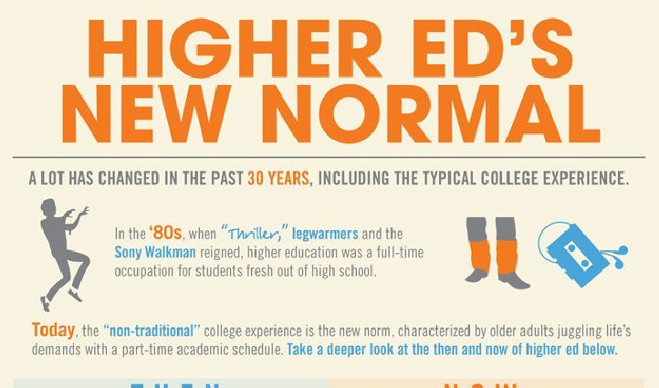
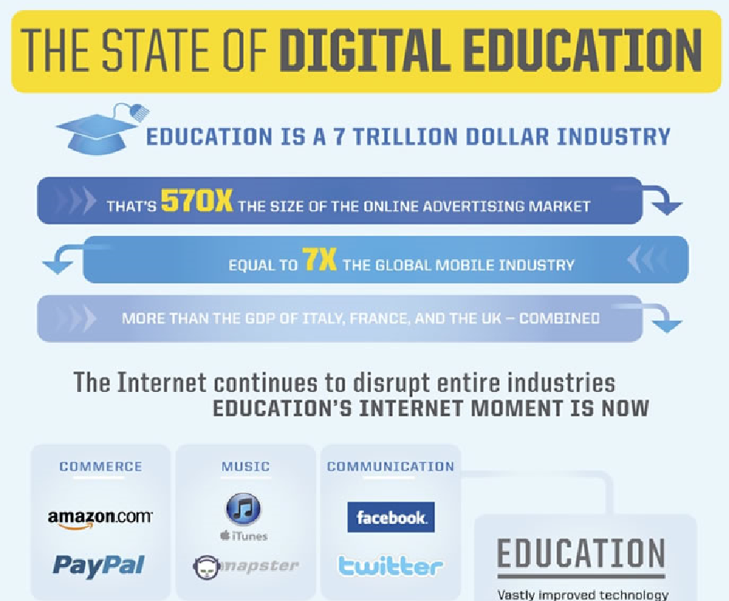
Along With Elvis, Has Education Left the Building?!
45% of students take an online class
67% of students use a smartphone to complete their assignments
75% of students are commuters who juggle jobs, families, and schools
Digital textbook sales have risen from 20% in 2010 to 40% in 2013
It is predicted that by 2020, 98% of learning will be hybrid/blended (we’re at 47% right now) – flipped?
Notes:
Connect rising costs of higher ed with previous slide

Slide 6
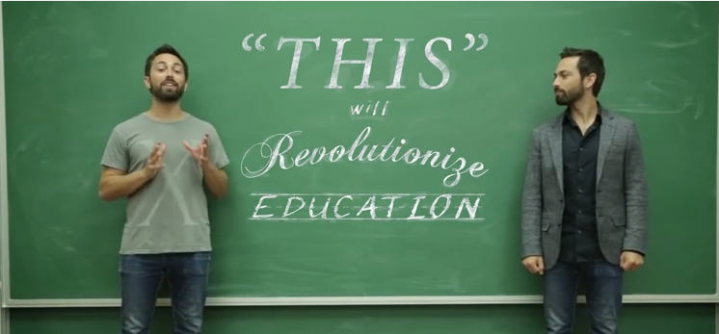
Will Education be Revolutionized?
Notes:
And these predictions continue today: MOOCs, Intelligent Tutoring Systems, Virtual Reality, etc… Main point of the video: Teachers help students to inspire and facilitate learning with groups of students => irreplaceable

Slide 7
Has It All Been Good?
“Median income in Silicon Valley reached $94,000…Yet an estimated 31 percent of jobs pay $16 per hour or less…The poverty rate in Santa Clara County, the heart of Silicon Valley, is around 19 percent.”
Notes:
Avg. salaries have gone down for lower 90%

Slide 8
Mission-Centered Education?
“isms” (e.g., racism, classism, sexism, etc., etc., etc.)
Overpopulation (> 7 billion)
Environmental Crises
Mass Migrations
Extreme Poverty
Wars, Genocides, etc.
https://en.wikipedia.org/wiki/History_of_the_United_States_(1918%E2%80%9345)
What roles do Education & Healthcare have in all of this? How do these relate to our Educated Citizen initiative?

Slide 9
Poll Everywhere Time!
What is one goal that you would set for yourself in the coming year?
Two options here:
Send a text to 37607 and begin the text message with “????” and then type your response
Go to the following website: PollEv.com/quickpolls

