Slide 1
NMC Standardized Student Evaluation Tool
Implementation of Invoke Higher Education:
CourseEval
Heather D. Henrichs, DC
Faculty Senate President

Slide 2
Continuous quality improvement

Slide 3
How did this come about?
Spring 2015 Term
Discussion of quality improvement with multiple stakeholders
Necessity for change
Moment of Shared Governance
Faculty Senate to create Ad Hoc Committee

Slide 4
What happened next?
Summer 2015
Ad Hoc formed and regular meetings began
2 Essential Questions
What are essential elements we as faculty envision a SET should assess?
What are ideal parameters for a SET?

Slide 5
Goals of Ad Hoc
Goals | Proposed Objective
1. Increase response rates | Set parameter to minimize survey fatigue Established maximum of 15 questions -Only have 3-5 questions per Category Create one survey to encompass multiple faculty Aggregate data from multiple survey periods for courses with small sample size or infrequently instructed to obtain better perspective of data Delivery of survey must interface with existing LMS Improved visibility and education regarding use of SET to both students and faculty
2. Establish Categories for Assessment Questions | Course Teaching Learning
3. Develop questions within each Category | Reference attached draft Student Evaluation Tool Questions v.2
4. Implement Pilot of Student Evaluation Tool | After demo from Academic Management System it was agreed to pilot utilizing their product Survey Monkey discussed to be utilized
5. Establish Reliability and Validity of Student Evaluation Tool | Utilize five point Likert Scale Will be in progress after pilot

Slide 6
Final SET Questions
1. The instructor actively assisted /facilitated my learning in the course.
2. The instructor provided feedback according to the stated time-frame.
3. The instructor provided feedback intended to improve my course performance.
4. The instructor was approachable and available for assistance.
5. The overall teaching and learning strategies contributed to meeting the course objectives.
6. I have a better understanding of the subject matter as a result of this course.
7. The course content contributed to my learning in this course.
8. The assigned course work contributed to my learning in this course.
9. The student-to-student interaction on assignments and/or discussions played an important role in contributing to my learning in this course.
10. The course challenged me appropriately for the subject matter, learning objectives, and course level.
11. The course was well planned and organized.
12. The course was easy to navigate.
13. The course objectives and expectations were clearly stated.
14. Any additional comments:

Slide 7
Implementation for Fall 2016
Reliability and Validity
Training
Support

Slide 8
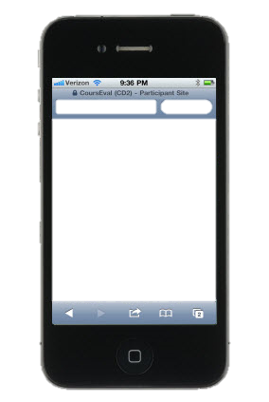
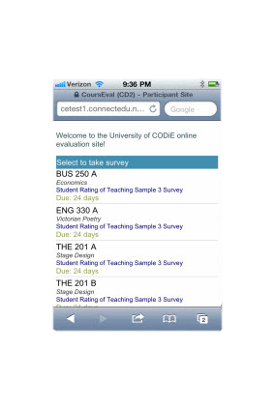
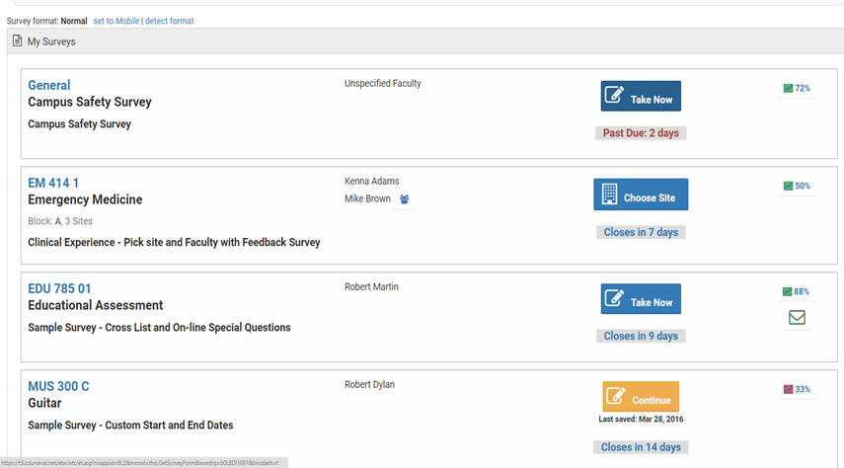
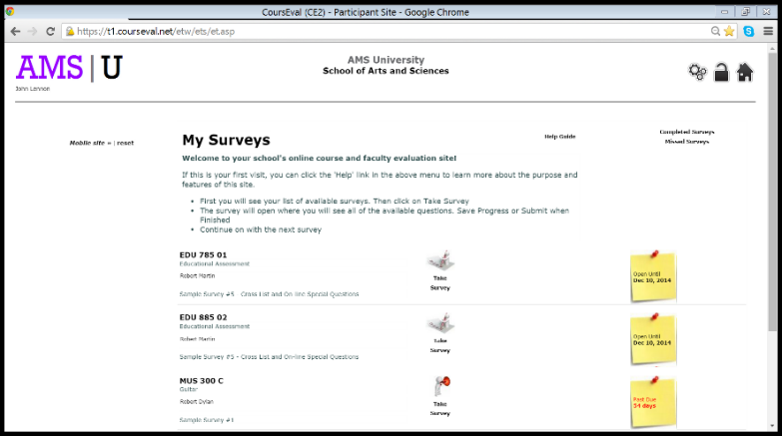
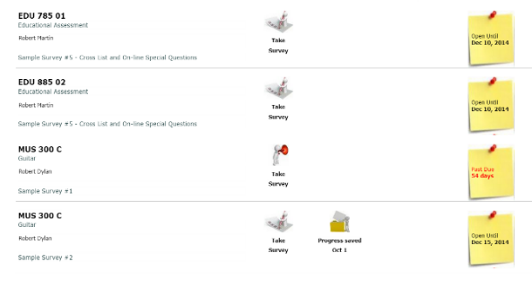
Any Device, Anywhere
Consider In-Class Administration
Student Dashboard on Tablet & Mobile Device
Notes:
Many instructors who want controlled survey administration will ask students to bring their mobile devices to class say, at 11am on Tuesday, and will open the survey then for 20 mins. Just like paper with the paper!
This is how CE looks on a smart device. The user may adjust the font size with a simple touch or by using standard smart phone zoom features. ADA compliant.

Slide 9
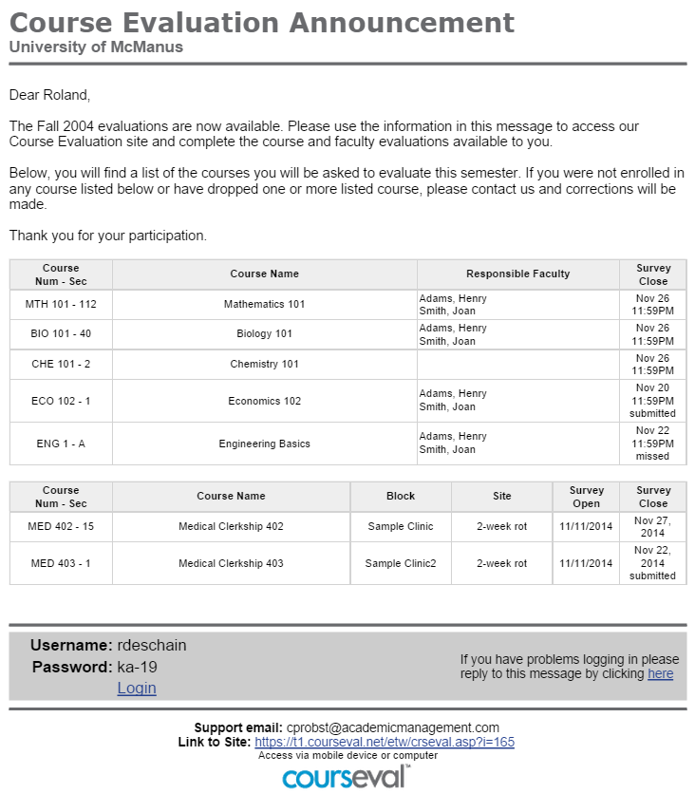
Courseval^{tm} Group Email To Students
Student Survey Announcement
Notes:
Students can access their surveys in two ways – the first is via email. Students click through the authenticated email. Reminders can be pre-programmed for release and will mention only the surveys that are active.

Slide 10
MyMethodist Navigation
After Login, Click Course Evals tab

Slide 11
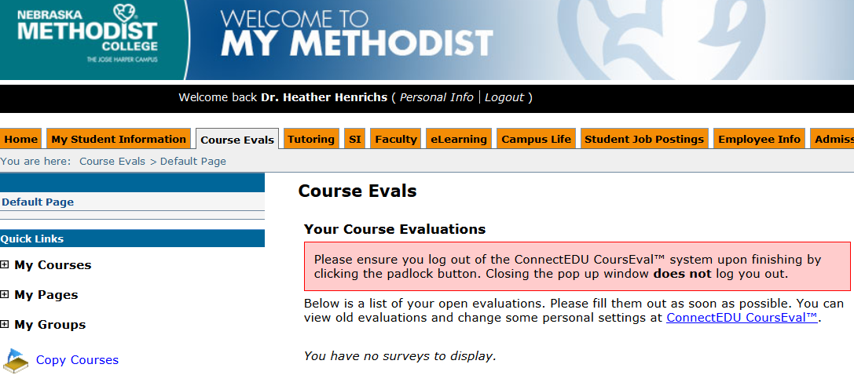
MyMethodist Navigation
CourseEval Link

Slide 12
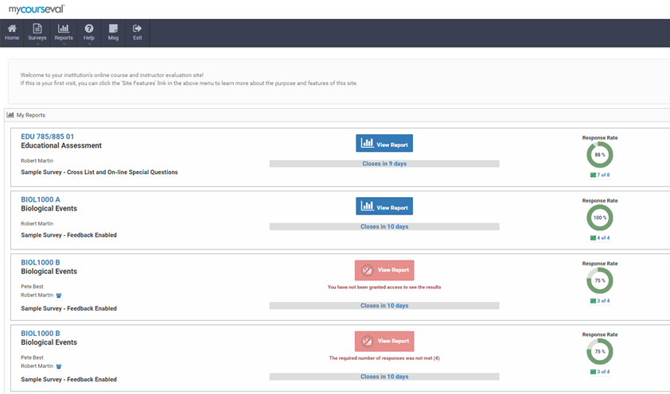
Instructor Landing Page
Notes:
Once surveys are complete and the course is over, you can alert instructors that they can access the reports from their landing pages. Results available only for courses where grades have been submitted. An instructor who enjoys a dual role in administration may view results other than his/her own, depending on an assigned role.

Slide 13
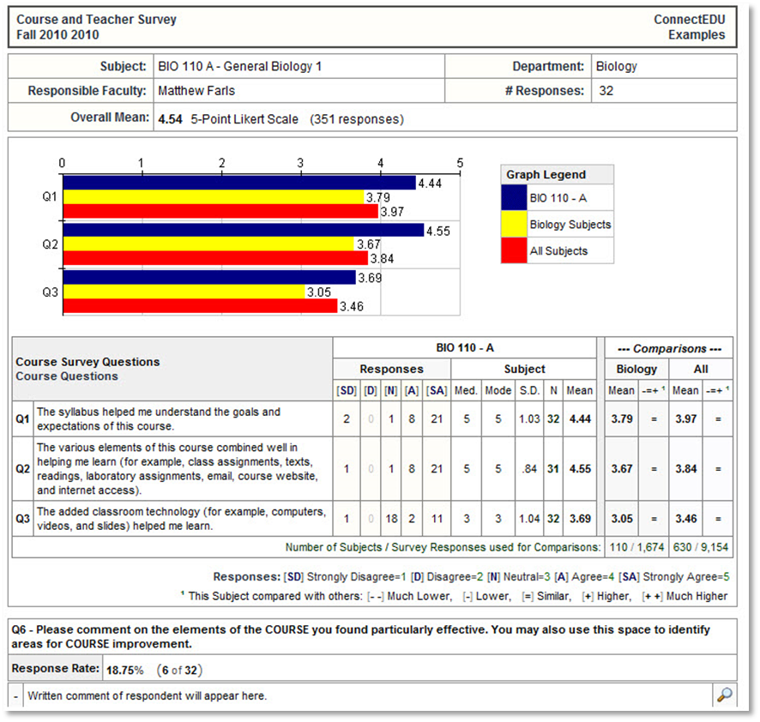
Sample of Feedback Report (Faculty)

Slide 14
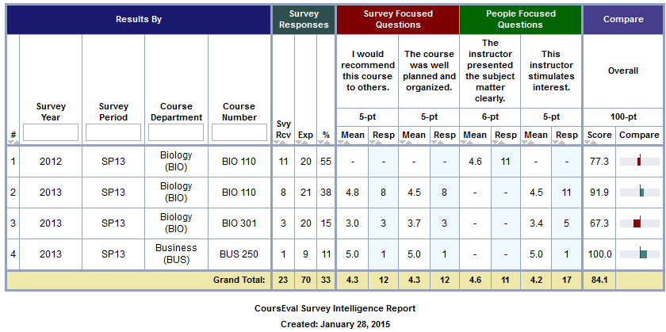
End of course, single instructor, multiple courses Over Time (Summative Use)
CourseEval Link

Slide 15
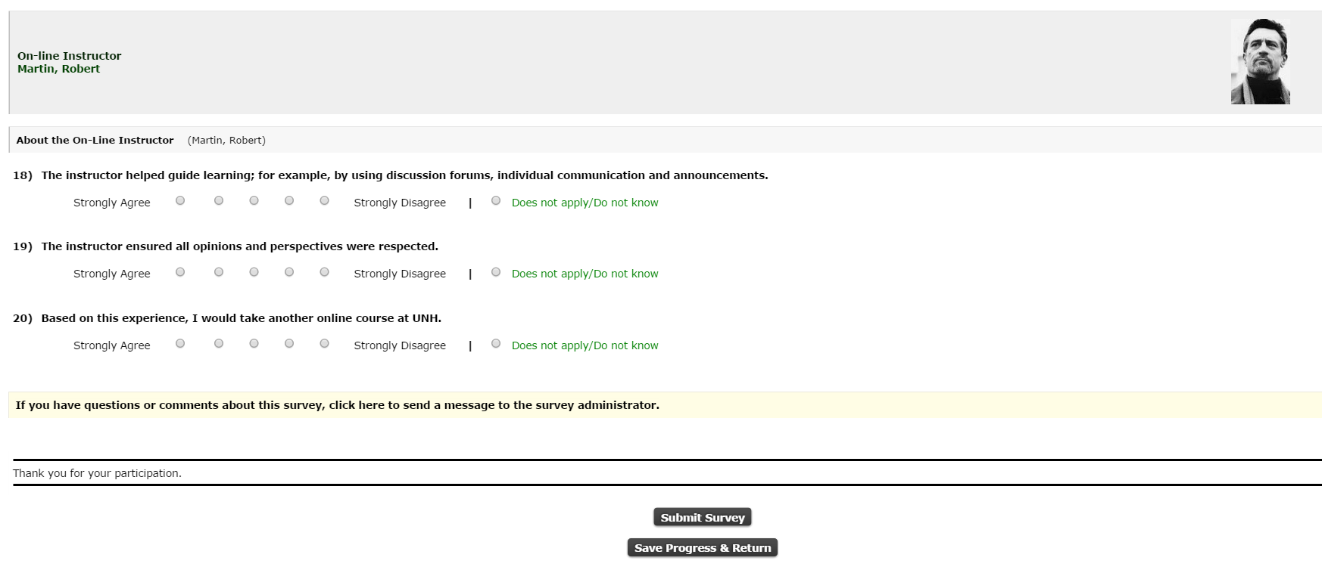
Separate Course & Instructor Questions
Notes:
And below the College/Dept questions come a set of questions particular to each instructor assigned the course. Photos are optional and can help identify instructors in team-taught classes. In team-taught classes, instructors would be able to see responses to the core questions and to their own questions – they would not be able to see responses to the other faculty items

Slide 16
Instructor-Added Questions
Notes:
Optional, but effective, individual instructor questions may be added as well. Many instructors appreciate the opportunity to ask directed questions about course-specific issues. Good as an engagement tool for faculty – in turn can help with student engagement

Slide 17
Instructor Scheduling
Open and close surveys
Notes:
Instructors can schedule the open and close of their own surveys, say for in-class administration, directly from their own landing page.

Slide 18
Continuous Quality Improvement
SET Survey
Response Types
Likert Scales
Multi-select
Open Ended
Question Delivery
Tiered
University Wide
Departmental
Course Type
Course Designation – Learning Objectives
Faculty Added & Specific Type
Other Surveys
Campus Services
Student Elections
Cap & Gown Orders
Dorm Satisfaction
Staff Questionnaires
Post Graduate
Peer Surveys
Self-Reflection
Con Ed Follow up

