Slide 1
Group Work that Transforms
Steelcase/NMC Active Learner-Centered Academy
August 7th and 16th, 2017
Dr. Heather Henrichs, Associate Professor, Arts & Sciences

Slide 2
TBL Pedagogy
Designed to
“support the development of high performance learning teams”
“provide opportunites for these teams to engage in significant learning tasks”
Mastery of content

Slide 3
TBL Pedagogy
Phases
Preparation
Readiness Assurance Process
Individual Readiness Assessment Test (iRAT)
Team Readiness Assessment Test (tRAT)
Application
Simple and complex group work
Assessment
Culminating team project or exam
Peer Evaluation

Slide 4
TBL Pedagogy
Forming Groups
Minimize Barrier to Group Cohesiveness
Distributing Member Resources
Teams Should be Fairly Large and Diverse
Permanent
Formed by Teacher

Slide 5
Application
Simple Group Work
Complex Group Work

Slide 6
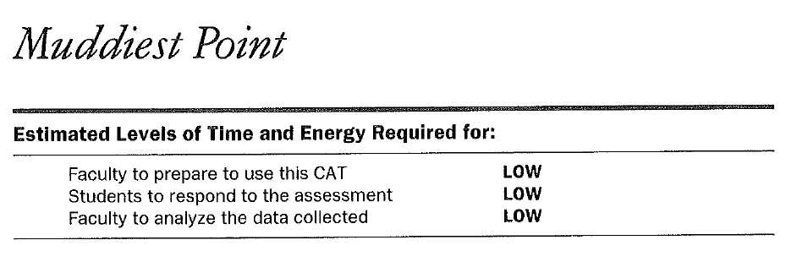
Simple Group Work
Classroom Assessment Focus Example

Slide 7
Complex Group Work
Classroom Assessment Focus Example

Slide 8
Assessment
Student Engagement Focus Example

Slide 9
Peer Evaluation
Preparation: Were they prepared when they came to class?
Contribution: Did they contribute productively to the team discussion and work?
Respect: Did they respect other team member’s ideas or views?
Gatekeeping: Did they help encourage other team members to contribute?
Flexibility: Did they listen when disagreements occurred?

Slide 10
Questions?

