Slide 1
Are you Ready to CREATE!?
Eric Kyle
August 2016

Slide 2
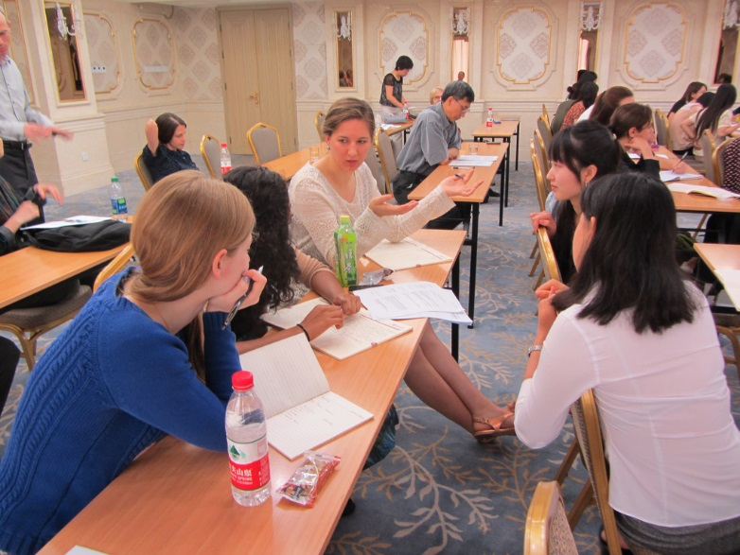
The Overall Message…
Turning to One Another!
https://www.flickr.com/photos/wellesleycollegemediarelations/9029991988

Slide 3
Vision & Mission
The vision of CREATE! is an innovative and dynamic culture of excellence in teaching and learning at Nebraska Methodist College (NMC).
In pursuit of this, CREATE’s mission is to nurture an environment that provides resources and opportunities for collaboration, pedagogical exploration, and inquiry for faculty, staff, and students.

Slide 4
The Center’s Goals
Promoting active teaching and learning strategies
Learner-centered and evidence-based course design methods
Development of authentic and varied assessment strategies
Ongoing development of leadership, collaboration, and scholarship

Slide 5
Pursuing these Goals
Finding & Developing a Series of Resources (e.g., evidence-based guidelines, MyMethodist site, etc.)
Focused Events (e.g., lunch & learns, workshops, eLearning modules, etc.)
A “Community of Support” System
Consultations & Feedback Sessions
Financial Support – Beginning in January…We hope
Down the Road…
Certification Program
Orientation to Teaching & Learning Program
Others?
https://pixabay.com/en/support-help-button-button-help-487506/

Slide 6
Fall Sessions
Evidence-Based Course Development Guidelines
Active Teaching & Learning Strategies
Lecture Capture & Synchronous Software
Helping Students to Come to Class Prepared

Slide 7
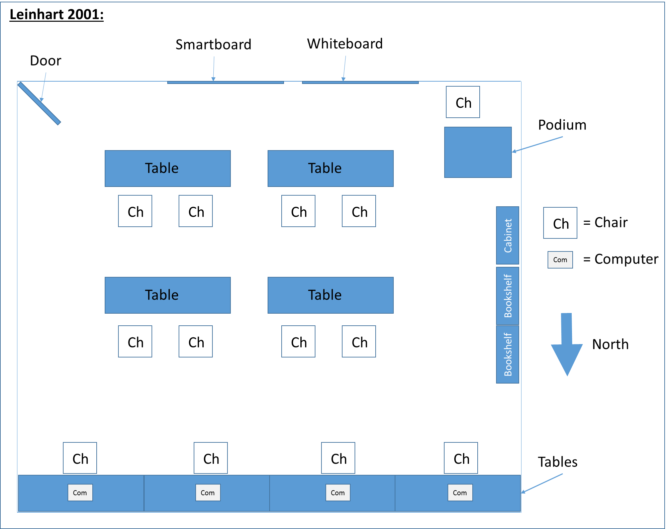
The Create! Space

Slide 8
Tracking Progress
Ultimately, it’s about continually improving the quality of teaching and learning on our campus
Evidence-Based Guidelines
Self-Assessments
Peer Feedback & Consultations
Reflections & Analyses on Courses
Badges, Certifications, CEUs
https://pixabay.com/en/ascending-graph-bar-graphs-progress-1173935/

Slide 9
CREATE! & Ed Tech
If it’s not working properly, contact NMC Help Desk (Ed Tech).
If you want to know how to use it more effectively in class, contact CREATE! staff.

Slide 10
Instructional Design Support
Moving more towards an empowering model of consultations, training, and supportive resources
Overall Goals:
Supporting more courses and programs across the college
Helping to improve the quality of teaching & learning as broadly as we can - prioritization
More effectively utilizing the gifts of our community – i.e., Turning to One Another!

Slide 11
Questions? Comments?

