Slide 1
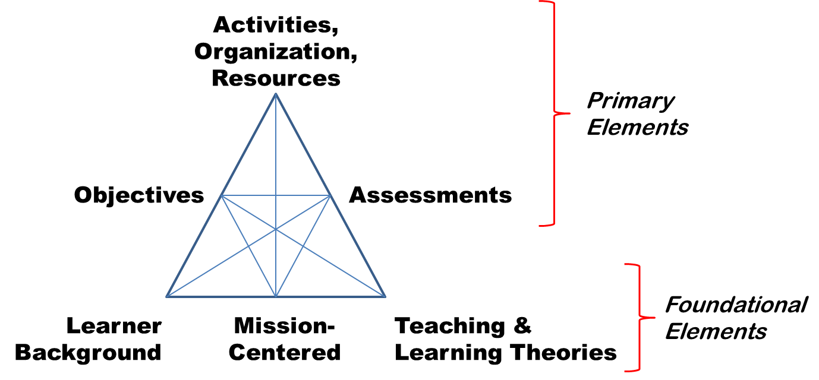
Some Essential Elements to Consider

