Slide 1
Taking a Risk
https://www.flickr.com/photos/mindonfire/6118598044
Making The Transition From Lecturing To Active Teaching & Learning
Cristy Daniel, College of Saint Mary
Eric Kyle, Nebraska Methodist College
Vicky Morgan, College of Saint Mary
Nebraska Methodist College
January 11, 2017

Slide 2
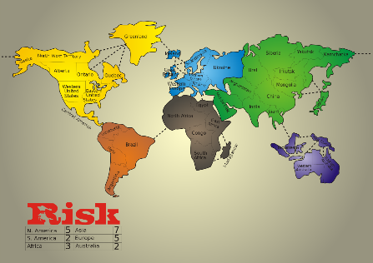
Overview
https://en.wikipedia.org/wiki/Talk%3ARisk_(game)/Archive_1
A brief sharing of your active teaching and learning strategies
Coffee Talk: Exploring one instructor’s journey from lecturing to active strategies
Data from the Journey
Sharing of one another’s journey and its successes/ challenges
“What risks will you take next?”
12:45
Vicky

Slide 3
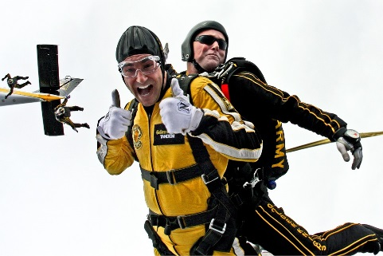
Group Discussion: How Active Are You?
https://pixabay.com/en/tandem-skydivers-skydivers-teamwork-603631/
What are some of the active teaching and learning strategies that you have used in your own courses?
When did you start using these?
Why did you start using them?
12:50
Vicky

Slide 4
Time for Coffee Talk: Everyone’s Invited!
Cristy, Vicky, Eric

Slide 5
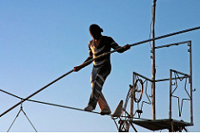
One Instructor’s Journey…
Began with lecture-only approaches
Made the transition to Socratic Questioning
Shifted to a Small Group, Case Study Format
Next Time: Flipped, pre-class quizzes, paired case studies
http://www.cmswire.com/information-management/businesses-risk-all-with-windows-server-2003/
1:10/15
Cristy, Vicky, Eric

Slide 6
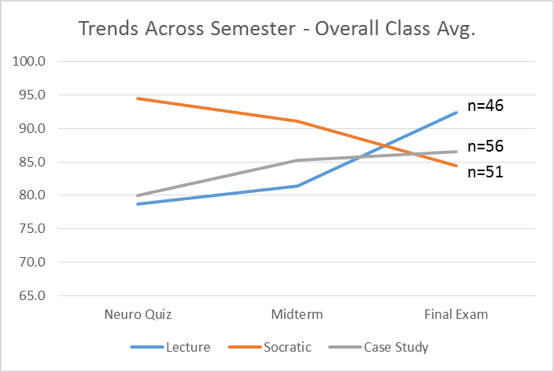
Data From The Journey
Eric

Slide 7
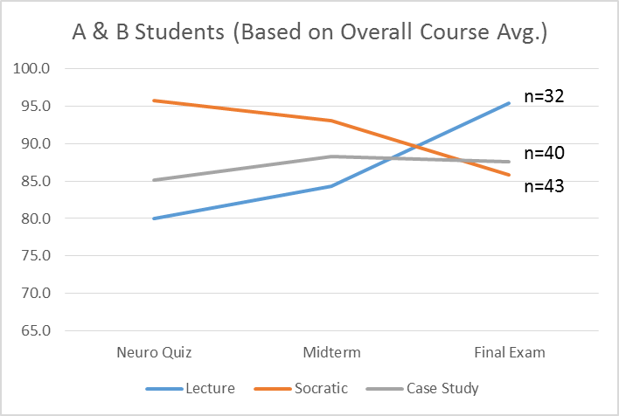
Data From The Journey
Eric

Slide 8
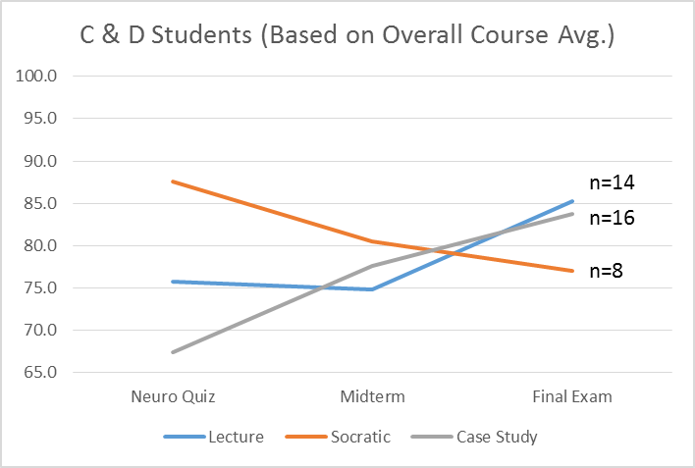
Data From The Journey
1:20
Eric

Slide 9
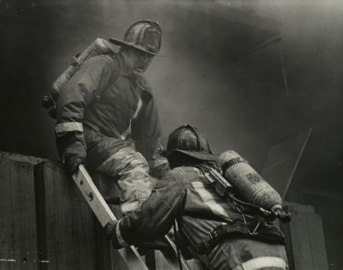
Think-Pair-Share: Bumps Along the Road?
https://en.wikipedia.org/wiki/Risk
How has your own journey with active teaching and learning strategies been?
What are two successes/celebrations that you have seen with active strategies?
What are two challenges that you have faced with active strategies?
1:25
Cristy

Slide 10
Questions? Comments?

Slide 11
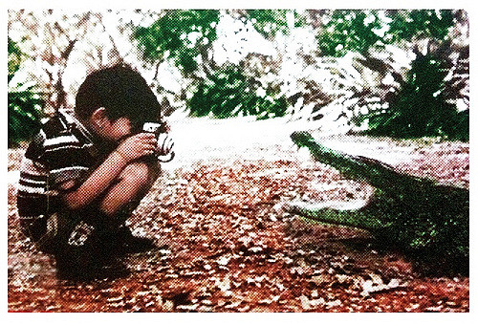
Back to Your Pairs: How Risky Are You?
https://www.flickr.com/photos/torres21/4115126733
What is one active strategy that you have been thinking about trying in one of your classes but have been afraid to try?
What support might you need to help you to take the risk and try out this active strategy?
If Time
Eric

