Slide 1
“Let’s Get Active” Hoedown!: An Active Teaching and Learning Strategy Swap
CREATE Series
Tuesday, December 6, 2016
Clark 2253
Dr. Heather Henrichs, Associate Professor, Arts & Sciences

Slide 2
How to create focus to your decisions for active teaching and learning strategies

Slide 3
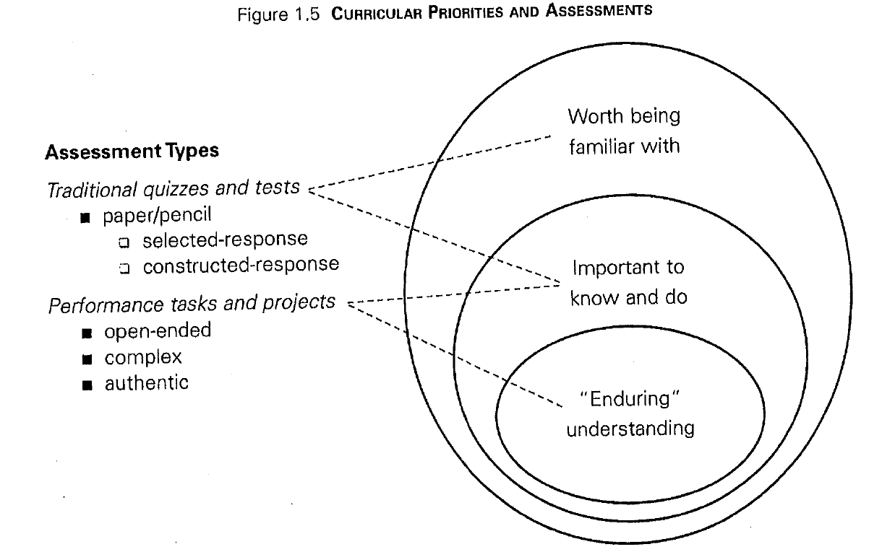
What is Backward Design?
Focus on “enduring concepts”¹

Slide 4
What is a TGI?
Teaching Goals Inventory ²
Focus on ‘enduring concepts’ related to clusters:
Higher-Order Thinking Skills
Basic Academic Success Skills
Discipline-Specific Knowledge and Skills
Liberal Arts and Academic Values
Work and Career Preparation
Personal Development

Slide 5
Selection of Strategy
Blended Model
Classroom Assessment Focus²
Student Engagement Focus³

Slide 6
Classroom Assessment Focus Example

Slide 7
Student Engagement Focus Example

Slide 8
Questions?

