Slide 1
Blended Huddle: A Team-based Case Study Teaching Integration Strategy
CREATE Series
Monday & Tuesday, April 17th & 18th, 2017
CREATE Center
Dr. Heather Henrichs, Associate Professor, Arts & Sciences

Slide 2
How to create focus to your decisions for active teaching and learning strategies
The Journey:

Slide 3
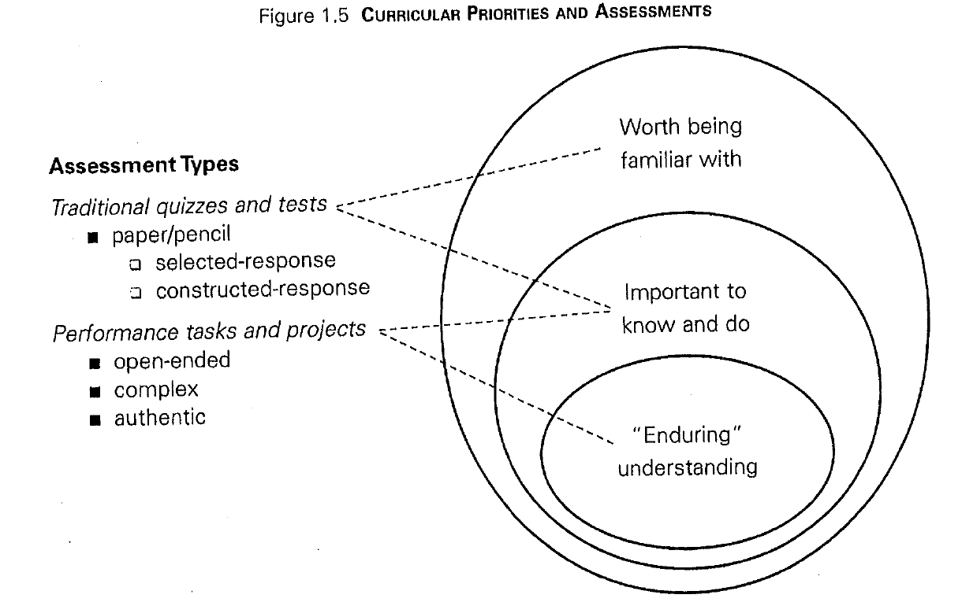
What is Backward Design?
Focus on “enduring concepts”¹

Slide 4
What is a TGI?
Teaching Goals Inventory ²
Focus on ‘enduring concepts’ related to clusters:
Higher-Order Thinking Skills
Basic Academic Success Skills
Discipline-Specific Knowledge and Skills
Liberal Arts and Academic Values
Work and Career Preparation
Personal Development

Slide 5
Selection of Strategy
Blended Model
Classroom Assessment Focus^{3, 2}
Student Engagement Focus^{3, 4}

Slide 6
TBL Pedagogy
Team-Based Learning
Individual Readiness Assessment Test (iRAT)
Team Readiness Assessment Test (tRAT)
Application
Modifications:
iQuiz
gQuiz
Application

Slide 7
Student Engagement Focus Example

Slide 8
Case Study Development/Methods
Small Group Method
Interrupted Case Method

Slide 9
Classroom Assessment Focus Example

Slide 10
Questions?

